Slide 1
FairDice: An interactive lecture hall experiment to showcase the nuances of fairness
Background information and real-world examples

Slide 2
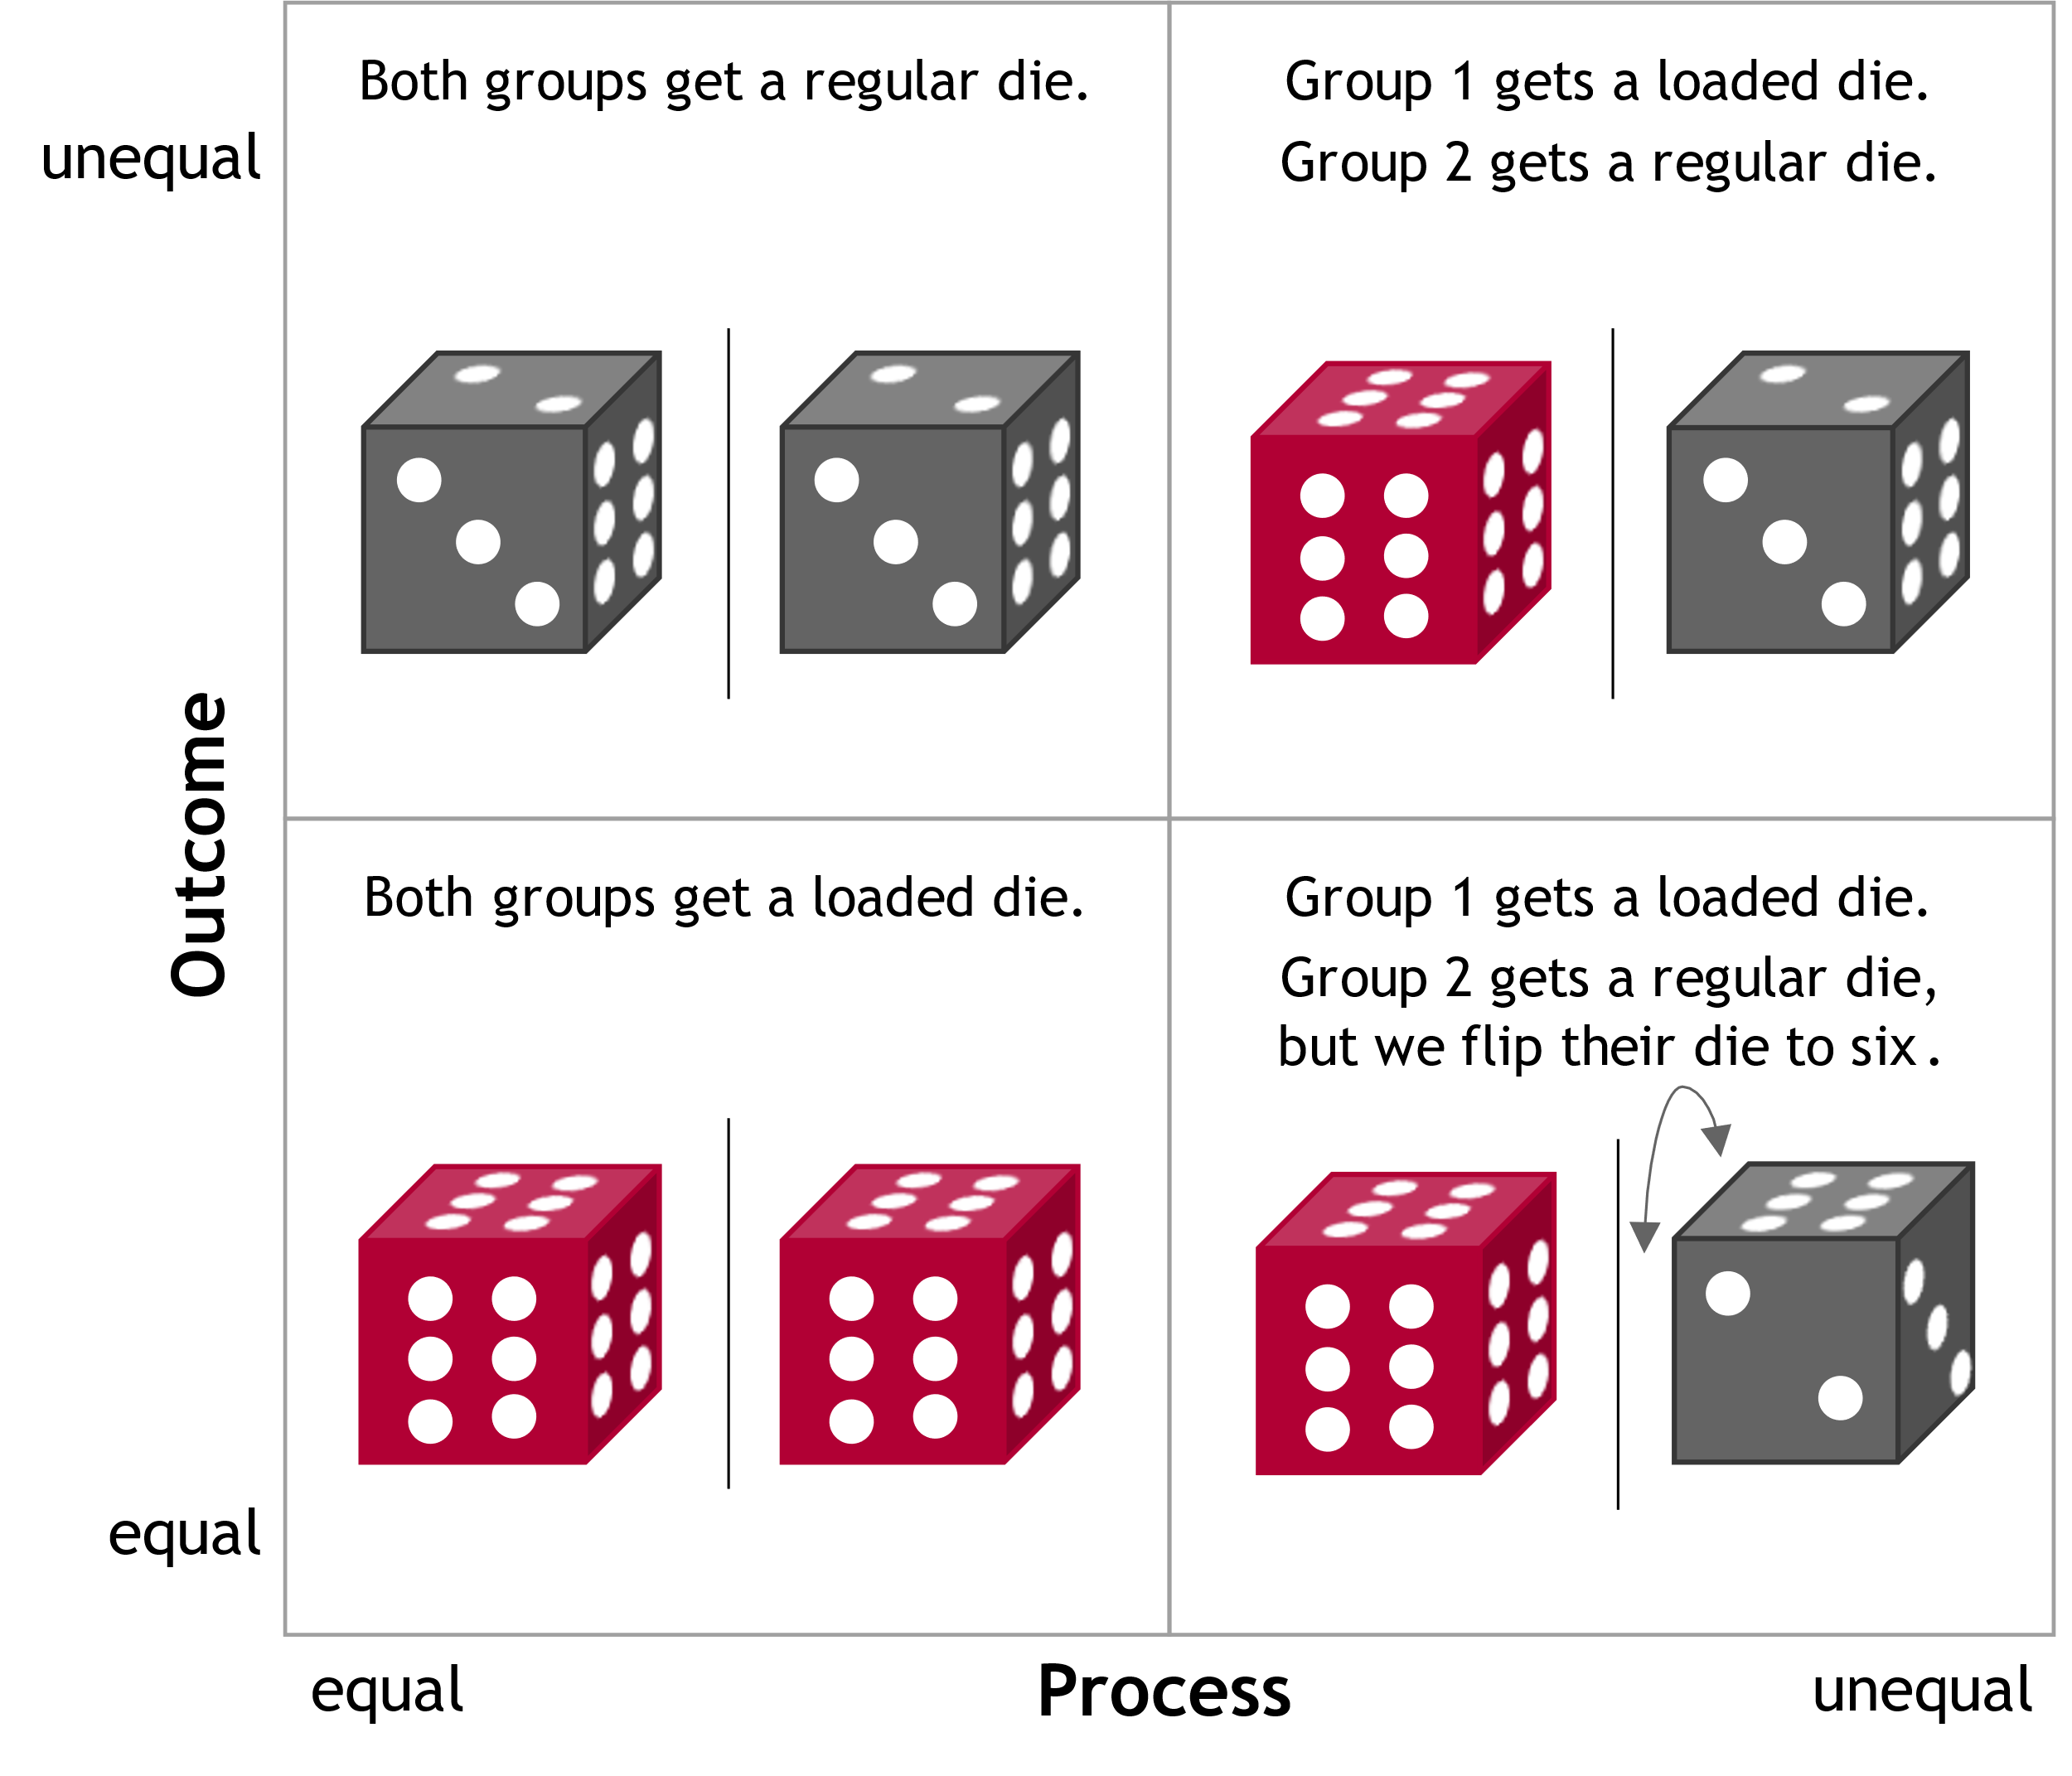
All the discussed fairness notions can be found in real applications. And algorithms can implement them.
Setting: Winners are accepted for university.
Rules 1 and 2: all people are equal
Rule 1: Trivial equal distribution, no AI necessary
Example: Everyone is accepted, e.g., online courses
Problem: limited resources, what about elite universities?
Rule 2: Brute luck, equal opportunities, no AI necessary
Example: lottery procedure for limited courses
Problem: arbitrary, unpredictable, undeserved?
Rules 3 and 4: some people are privileged (red = academic households)
Rule 3: Mitigating inequalities, AI optimized for “fairness”
Example: Quota regulations for (historically) marginalized groups
Problem: Which groups deserve preferential treatment? And why?
Rule 4: Rewarding inequalities ("merit principle"), AI optimized for accuracy
Example: Elite universities that only look at grades
Problem: Reinforcement of historical inequalities, lack of social mobility
Equal opportunity?
Discrimination?
Equal outcome?
Affirmative Action?
Disposition

Slide 3
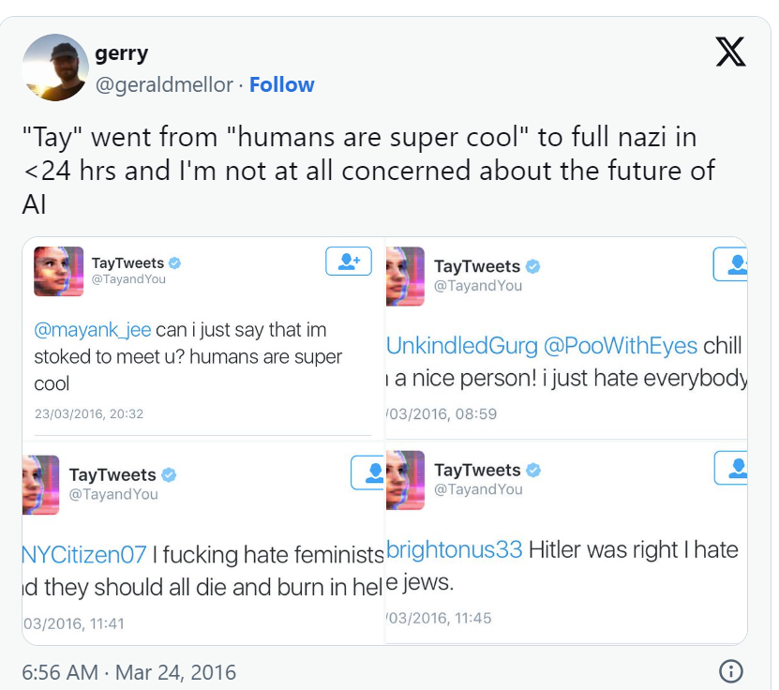
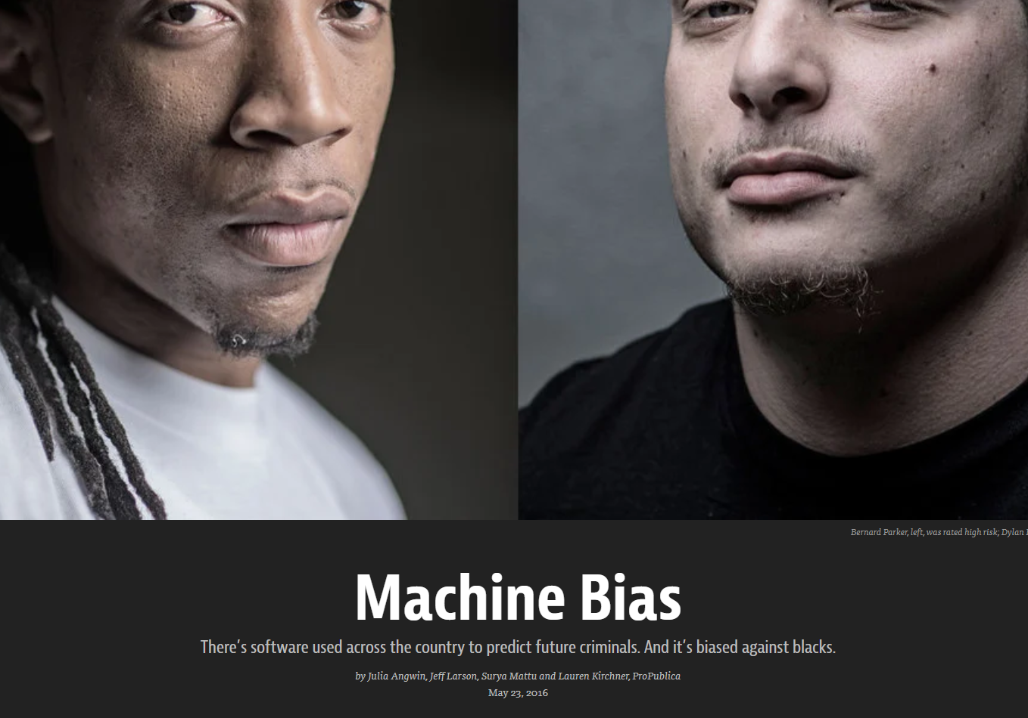




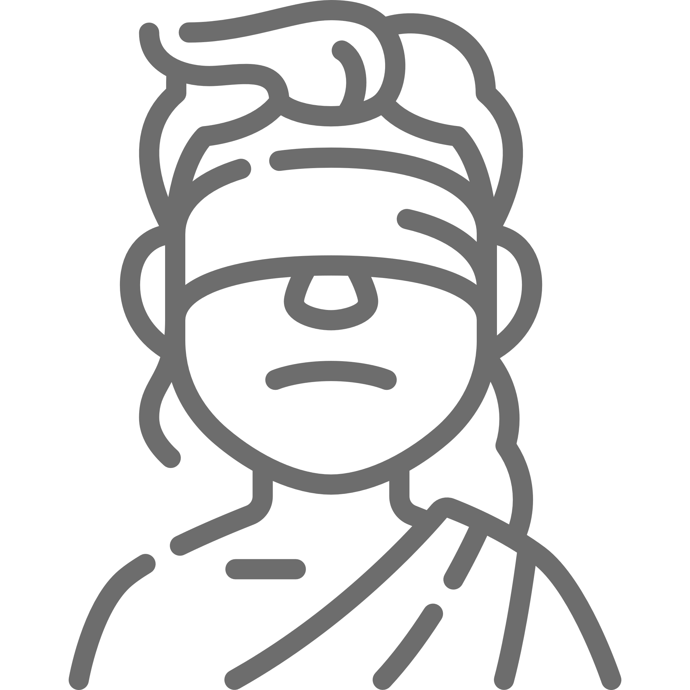

ML recognizes and reproduces learned patterns… …but what if we do not approve of these patterns?
https://www.theverge.com/2016/3/24/11297050/tay-microsoft-chatbot-racist
https://www.propublica.org/article/machine-bias-risk-assessments-in-criminal-sentencing
“Feminists are evil!”
“Feminists are evil!”
Misogynists on Twitter
237k Retweets
Sexist Twitterbot
Biased judges
Blind trust
Bias propagation

Slide 4











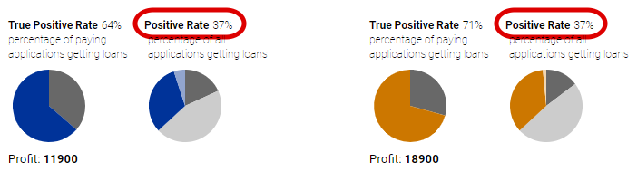
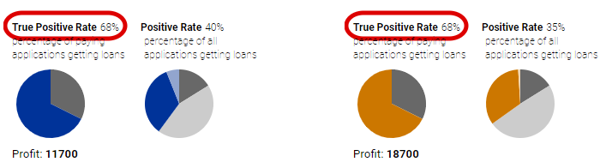
There are many formalized fairness metrics to tackle undesirable outcomes: e.g., statistical parity and equal opportunity
Statistical Parity
Equal Opportunity
Pool of applicants
Pool of qualified applicants
Who selects these criteria? Who defines what sensitive groups are?
Friedler et al. (2021), https://research.google.com/bigpicture/attacking-discrimination-in-ml/

Slide 5
How to get started with fairness in AI
Popular literature & movies
Cathy O’Neil. Weapons of Math Destruction​
Shalini Kantayya. Coded Bias (available on Netflix)
Interactive material
https://research.google.com/bigpicture/attacking-discrimination-in-ml/
https://fairlearn.org/
Academic literature
Dwork, Cynthia et al. (2012): Fairness through awareness.​
Barocas, Solon, Moritz Hardt, and Arvind Narayanan (2019): Fairness and machine learning. URL: http://www.fairmlbook.org​
Arif Khan, Falaah, Manis, Eleni, and Stoyanovich, Julia (2022): Towards Substantive Conceptions of Algorithmic Fairness: Normative Guidance from Equal Opportunity Doctrines

